Slide 1













Sarcasm detection using NLP

Slide 2
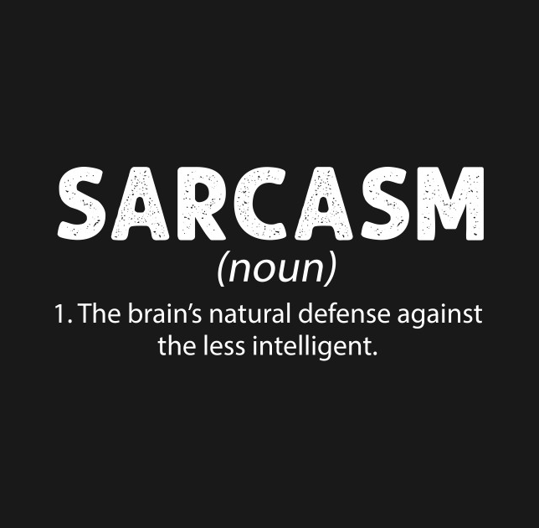
Introduction
Sarcasm, that sly, playful friend of irony, has long eluded the grasp of machines. But with the rise of Natural Language Processing (NLP), a new dawn is breaking. We're now equipped with tools to delve into the depths of human communication and finally understand the subtle nuances of sarcasm.
Imagine a world where machines can decipher the "not really" behind a "great weather, huh?". A world where robots don't take your "loving" punch in the arm literally. This is the promise of sarcasm detection, and NLP is the key.

Slide 3

Abstract
The emergence of Natural Language Processing (NLP) offers a new lens to decode the subtleties of sarcasm. This paper explores the complexities of sarcasm detection and the promise that NLP holds in unlocking its secrets. We delve into the linguistic, sentimental, and contextual intricacies that make sarcasm so elusive. We then showcase how NLP techniques, ranging from machine learning to deep learning, are being employed to identify sarcasm markers and bridge the gap between literal and intended meaning. In this study, we aim to minimise the amount of data required to achieve near-optimal performance in sarcasm detection. We employ two datasets composed of concise texts: iSarcasm- tweets and SARC- Reddit post comments. To reduce the size of the training dataset, we implemented a data pruning method. Additionally, we investigate various loss functions.

Slide 4


Related Work
The authors of the paper fine-tuned the sarcasm detection model based on RoBERTa and found that fine-tuning RoBERTa for sentiment classification, without data augmentation and further fine-tuning only on the iSarcasm dataset, achieved the best performance with an F1 score of 0.414. However, this fell short of the RoBERTa model fine-tuned for sarcasm detection by Hercog et al., which utilized a training set comprising iSarcasm and a subset of SARC, achieving a higher F1 score of 0.526 on iSarcasm.

Slide 5
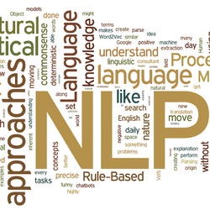
Methodology
Employed the student-teacher perceptron learning technique to classify SARC training samples based on confidence (logit score) and created three new datasets: iSarcasm + 10,000 SARC training examples misclassified with the lowest confidence (Easy SARC Examples), iSarcasm + 10,000 SARC training examples misclassified with the highest confidence (Hard SARC Examples), and iSarcasm + 10,000 random SARC examples. They found that using the dataset with easy SARC examples outperforms the baseline. Additionally, they investigated the effectiveness of various loss functions in enhancing sarcasm detection performance and found that alternative loss functions, particularly Weighted Cross Entropy Loss, can improve sarcasm detection performance compared to the standard Cross Entropy Loss.

